Slide 1

Computer Architecture
Keivan Navi
Cal Poly Pomona University
knavi@cpp.edu
Office hours: Tu/Th 5:25 Pm to 6:55 Pm
Office: 8-49

Slide 2
Computer Architecture
Shift and Rotate

Slide 3
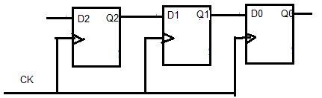





Shift Right
The Schema of Shift Right follows:
One bit Shift Right
2 bits Shift Right
3 bits Shift Right
4 bits Shift Right

Slide 4
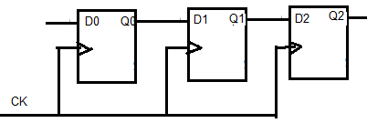





Shift Left
The Schema of Shift Left follows:
One bit Shift Left
2 bits Shift Left
3 bits Shift Left
4 bits Shift Left

Slide 5
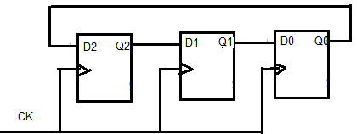





Rotate Right
The Schema of Rotate Right follows:
One bit Rotate Right
2 bits Rotate Right
3 bits Rotate Right
4 bits Rotate Right

Slide 6
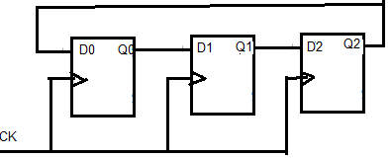



Rotate Left
The Schema of Shift Left follows:
One bit Shift Left
2 bits Shift Left
3 bits Shift Left
4 bits Shift Left

Slide 7
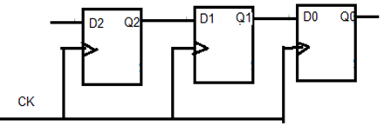
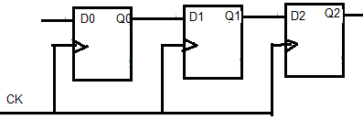
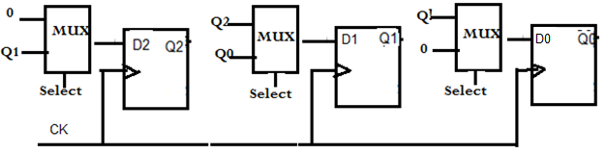
Shift Right/ Shift Left
How can we combine them together?
If Select=0 then Shift Right
If Select=1 then Shift Left

Slide 8

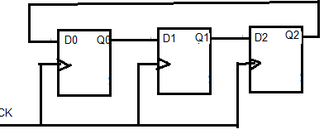
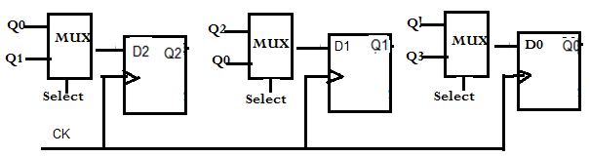
Rotate Right/ Rotate Left
How can we combine these together?
If Select=0 then Shift Right
If Select=1 then Shift Left

Slide 9
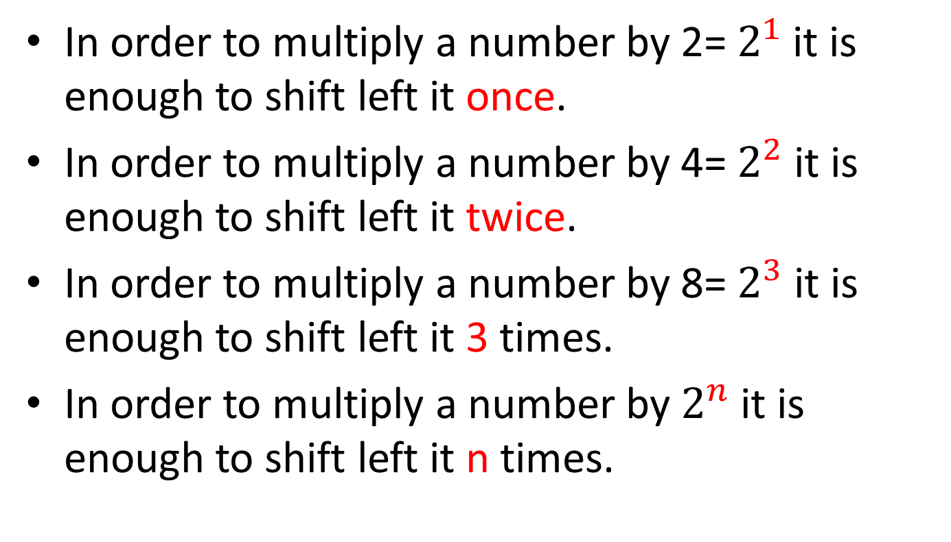
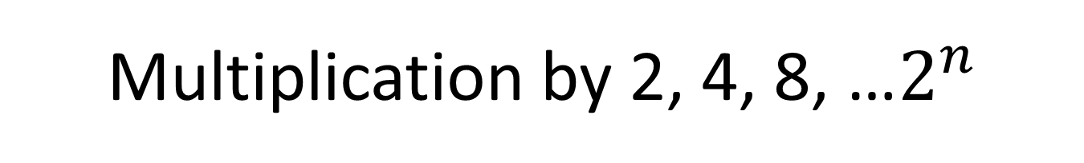
Multiplication by 2, 4, 8, …$2^{n}$
In order to multiply a number by 2= $2^{1}$ it is enough to shift left it once.
In order to multiply a number by 4= $2^{2}$ it is enough to shift left it twice.
In order to multiply a number by 8= $2^{3}$ it is enough to shift left it 3 times.
In order to multiply a number by $2^{n}$ it is enough to shift left it n times.

Slide 10
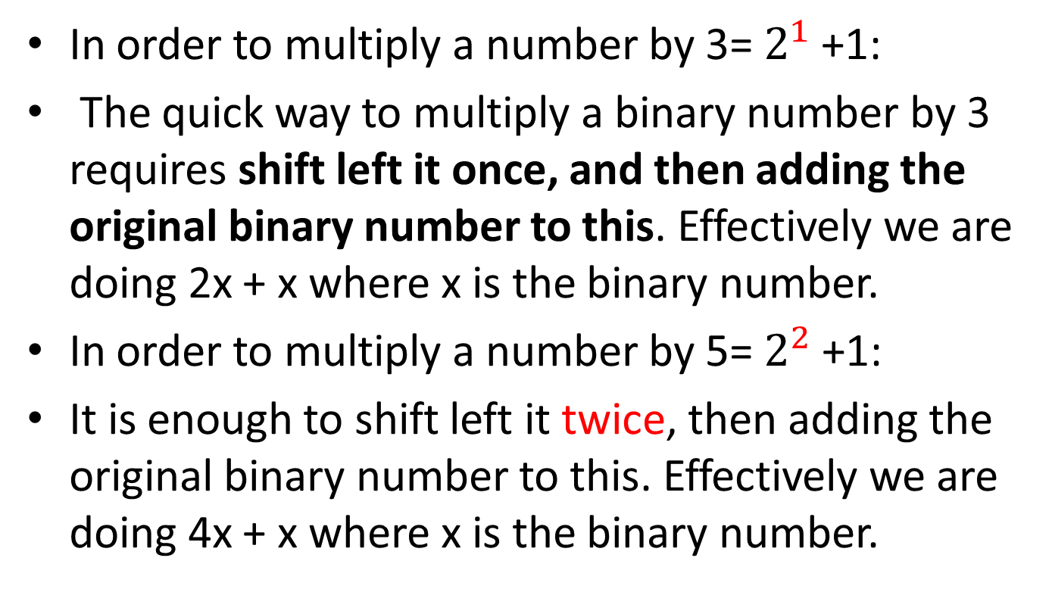
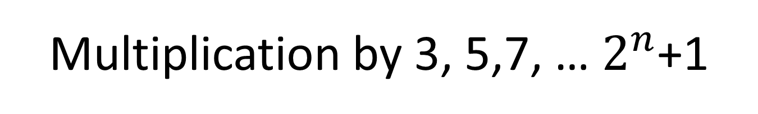
Multiplication by 3, 5,7, … $2^{n}$+1
In order to multiply a number by 3= $2^{1}$+1:
The quick way to multiply a binary number by 3 requires shift left it once, and then adding the original binary number to this. Effectively we are doing 2x + x where x is the binary number.
In order to multiply a number by 5= $2^{2}$+1:
It is enough to shift left it twice, then adding the original binary number to this. Effectively we are doing 4x + x where x is the binary number.

Slide 11
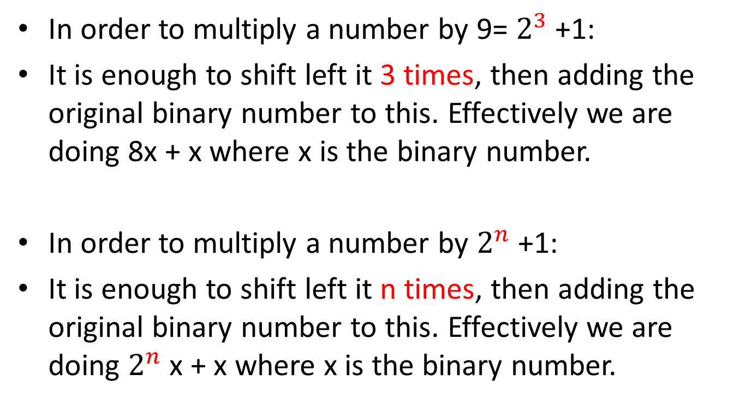
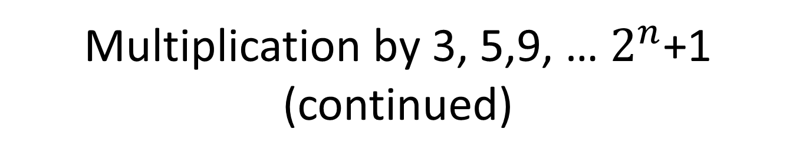
Multiplication by 3, 5,9, … $2^{n}$+1 (continued)
In order to multiply a number by 9= $2^{3}$+1:
It is enough to shift left it 3 times, then adding the original binary number to this. Effectively we are doing 8x + x where x is the binary number.
In order to multiply a number by $2^{n}$+1:
It is enough to shift left it n times, then adding the original binary number to this. Effectively we are doing $2^{n}$x + x where x is the binary number.

Slide 12
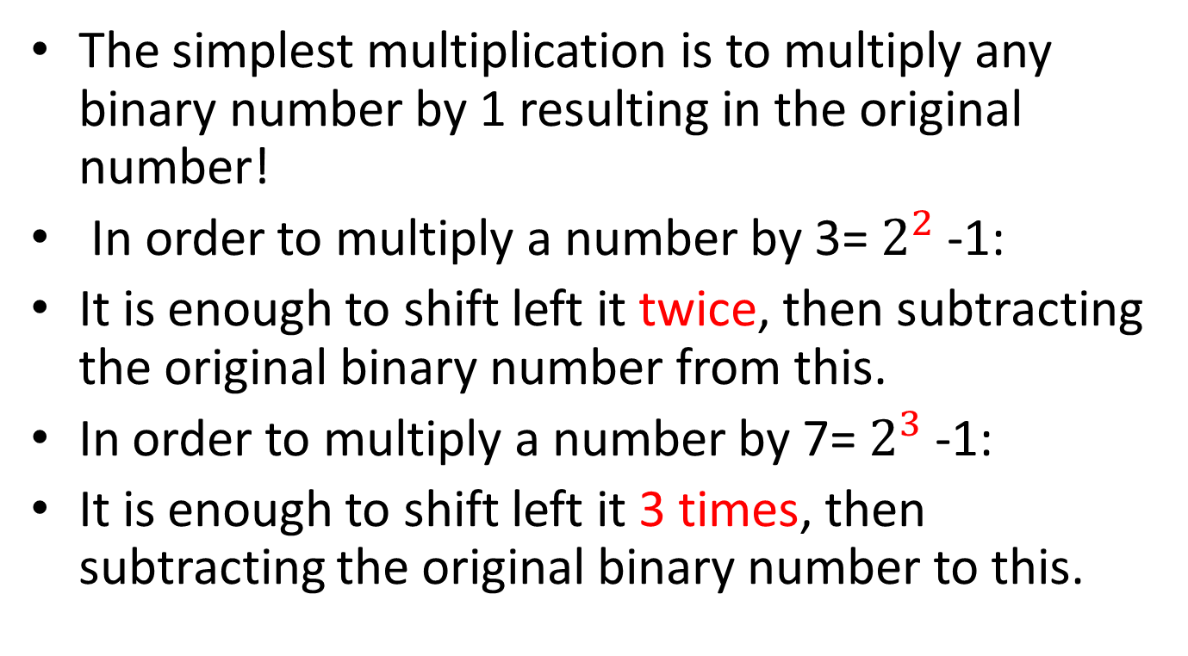
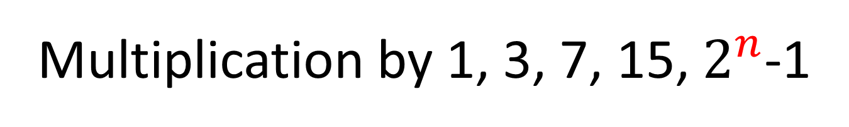
Multiplication by 1, 3, 7, 15, $2^{n}$-1
The simplest multiplication is to multiply any binary number by 1 resulting in the original number!
In order to multiply a number by 3= $2^{2}$-1:
It is enough to shift left it twice, then subtracting the original binary number from this.
In order to multiply a number by 7= $2^{3}$-1:
It is enough to shift left it 3 times, then subtracting the original binary number to this.

Slide 13
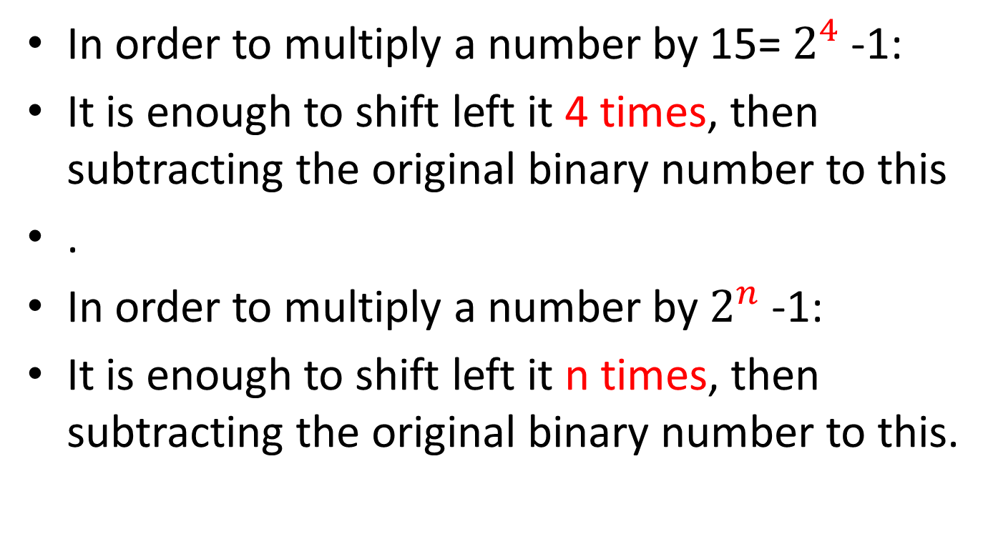
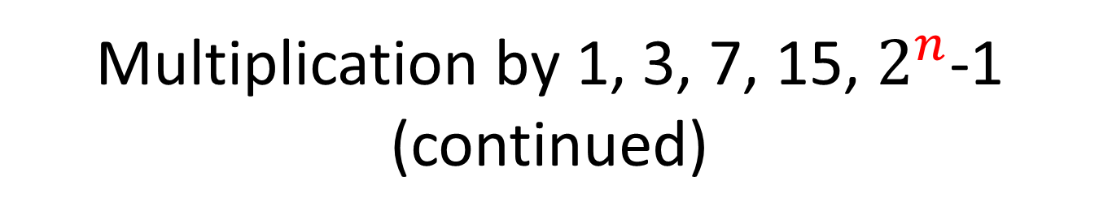
Multiplication by 1, 3, 7, 15, $2^{n}$-1 (continued)
In order to multiply a number by 15= $2^{4}$-1:
It is enough to shift left it 4 times, then subtracting the original binary number to this
.
In order to multiply a number by $2^{n}$-1:
It is enough to shift left it n times, then subtracting the original binary number to this.

Slide 14
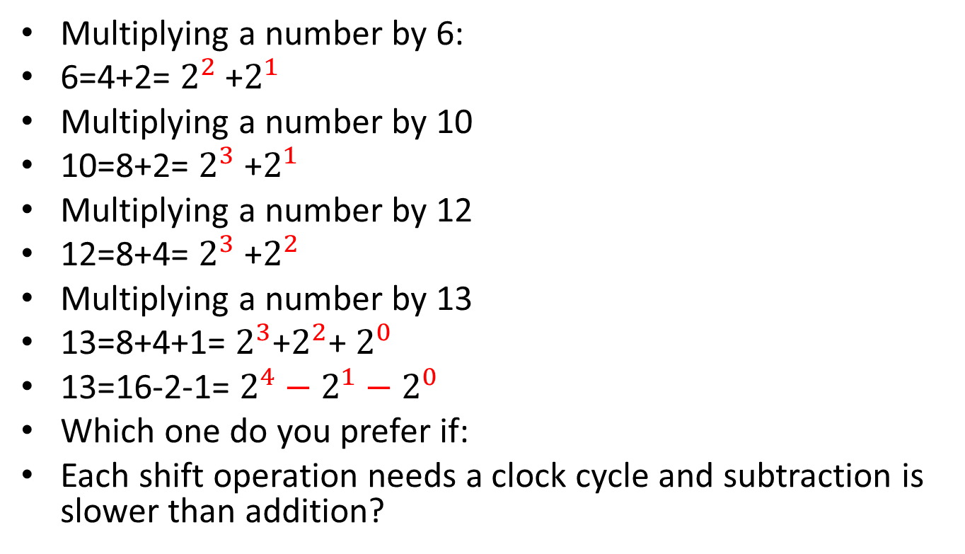
Multiplication by 6, 10, 12,13
Multiplying a number by 6:
6=4+2= $2^{2}$ +$2^{1}$
Multiplying a number by 10
10=8+2= $2^{3}$ +$2^{1}$
Multiplying a number by 12
12=8+4= $2^{3}$ +$2^{2}$
Multiplying a number by 13
13=8+4+1= $2^{3}$+$2^{2}$+ $2^{0}$
13=16-2-1= $2^{4}−2^{1}−$ $2^{0}$
Which one do you prefer if:
Each shift operation needs a clock cycle and subtraction is slower than addition?

Slide 15
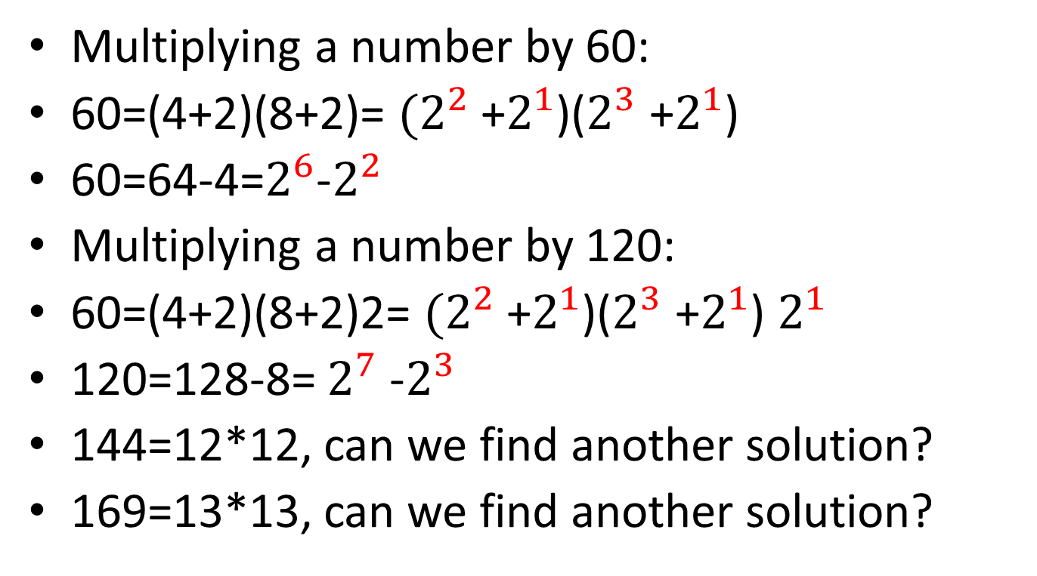
Multiplication by 60, 120, 144,169
Multiplying a number by 60:
60=(4+2)(8+2)= $(2^{2}$ +$2^{1}$)($2^{3}$ +$2^{1}$)
60=64-4=$2^{6}$-$2^{2}$
Multiplying a number by 120:
60=(4+2)(8+2)2= $(2^{2}$ +$2^{1}$)($2^{3}$ +$2^{1}$) $2^{1}$
120=128-8= $2^{7}$ -$2^{3}$
144=12*12, can we find another solution?
169=13*13, can we find another solution?

